Slide 1
A-scI-W
Making Instructional Decisions
to Support Students
in Their Learning of Science
Leif Segen
Co-Creator of Learning Environments
(Teacher & Science Dept. Chair)
South Hamilton CSD

Slide 2
Get to Know Each Other
Name
District
How would the world be different if the moon were 50% larger? No right or wrong answers, just play.
One thing you’ve been curious about lately
BIG
Notes:
Moon: Are we talking about diameter, volume, or mass? People will think they’re a little bit crazy.

Slide 3

Get to Know Each Other
Name
District
How would the world be different if the moon were 50% larger? No right or wrong answers, just play.
One thing you’ve been curious about lately
BIG, Step Brothers

Slide 4
Setting
Rural District
55 students per class
Courses taught
  Physics
  Foundations of Science (9th grade)
  Principles of Engineering (PLTW)
  Digital Electronics (PLTW)
  Current Science

Slide 5
The Heart of AIW
Notes:
On board: four words

Slide 6

The Heart of AIW

Slide 7
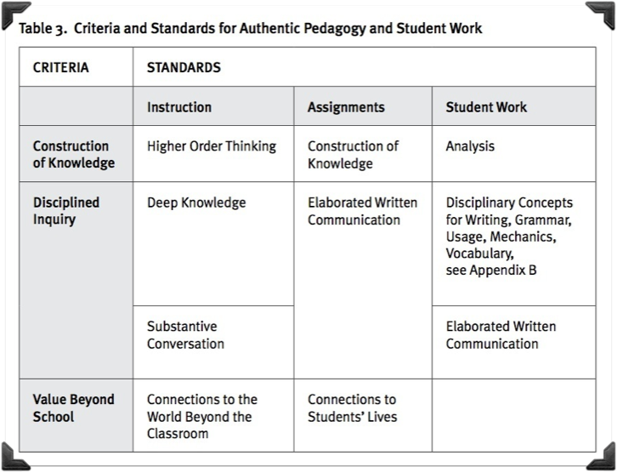

Gold, Right?

Slide 8
What’s Missing?

Slide 9

What’s Missing?

Slide 10
What’s Missing?
Notes:
Let participants mull over what could be here.
Present to local farmer’s association?
Dialog with families and report back namelessly.

Slide 11
Current Science
Major topics explored so far
  Data Collection & Data Analysis
  Astronomy & Cosmology
  Extreme Biology & Anatomy
  Energy Storage & Transfer

Slide 12
Current Science:
Climate Change
Prior understanding shared by students:
  Earth simply goes through cycles
  “I don’t care about that.”
  “I’m from Iowa. I’m from a farm family. I don’t believe in it.”
  There’s no way humans caused it.
  The oceans are flooding, right?
Notes:
Been on my heart and mind for a while. Students chose it.
Here’s what I thought…

Slide 13
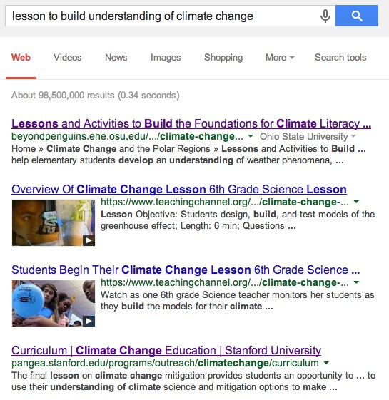
Cliché But Works

Slide 14
Sequence So Far
Intro
Reasoning
Student questions <-----> Stanford Resources
& Supplements
Notes:
LESSON
You have a super novice level of umnderstanding
Q examples: Why does 400 ppm CO2 matter?
Why should I even care? This is Iowa.

Slide 16
AIW Framework

Slide 17
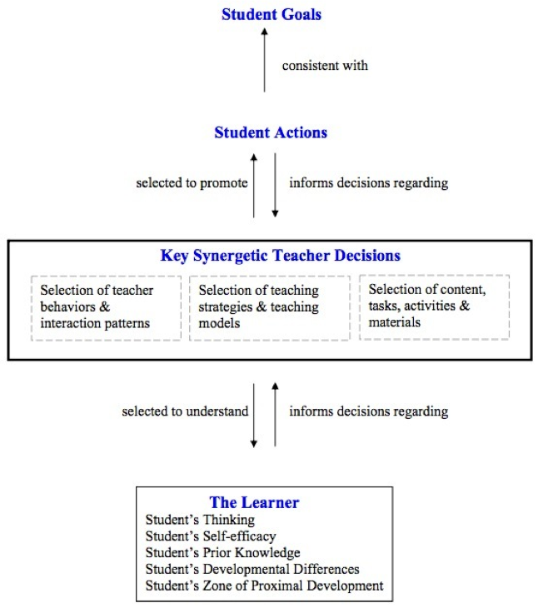
Framework for Teacher Decision-Making
Clough, Berg, Olson

Slide 19
AIW Framework

Slide 20
Instruction – S1:
Higher Order Thinking
Lawson Test of Scientific Reasoning
  Informs teacher of Piagetian stage of cognitive development:
    Concrete
    Transitional
    Formal Operational

Slide 21
AIW Framework

Slide 22
Instruction – S2:
Deep Knowledge
Physics & Foundations of Science
  Not: Memorize Newton’s Laws
  Rather:
    1) Observe
    2) Formulate into student-composed laws
Current Science – climate change
  Not: Telling students the current sci. consensus
  Rather: Identify student questions. Provide students the opportunity to discover answers.

Slide 23
Instruction – S3:
Substantive Conversation
Rowe, M. “Wait-Time: Slowing Down May Be a Way of Speeding Up.” Journal of Teacher Education, Jan-Feb 1986.
  Wait Time 1
  Wait Time 2
Multitude of Effects on Teacher and Student
Notes:
S:
Failuresto respond decrease
T:
l. Teachers' responses exhibit greater flexibility
2. The numbr and kind of questions asked by teachers changes.

Slide 24
Instruction –
My Journey
Co-creating a learning environment
  Ask real questions
  Student-driven discourse
  Authentic audience

Slide 25
AIW Framework

Slide 26

Assignments
Council for 21st Century Learning
Notes:
Whiteboard:
As adults, how do we learn about the things we’re curious about?
Do we make instructional decisions based on this?
How do you perceive students will respond to this?

Slide 27
AIW Framework - Assignments
Promotes:
  cognitive development
  emotional engagement
  connection to students’ lives and the community
Perceived limitations of teacher-provided assignments
  Doesn’t build students’ abilities to choose what and how they learn
  Students are passive
Notes:
Limitation = Not seeing in AIW documents AND not seeing in MY teaching
Active in terms of thinking and communicating learning
Just passive in terms of directing their learning
How can we address these gaps in teaching?

Slide 28
AIW Framework

Slide 29
Assignments – S2: Elaborated Written Communication
Fantastic:
  Students are challenged to express their understanding
Perceived limitation:
  Reading student work and providing substantive feedback proves daunting with multiple courses and large numbers of students.

Slide 30

Authentic Assignments
Council for 21st Century Learning

Slide 31
AIW Framework – Evaluating Student Work

Slide 32

Assessment
Council for 21st Century Learning

Slide 33
AIW Framework – Evaluating Student Work
(Assessment)
Helpful challenge to teacher:
  Majority of assessment standards are about metacognition and communication methods.
AIW guidelines claim a limited scope:
  Written work, not:
    investigative work
    experiment design
    making decisions about life & society
Notes:
When we assess what matters, this helps students grow in that area AND helps teachers grow in that area.
Looking at the needs of our quickly changing society (NGSS), we see the need for these listed.
… so …

Slide 34
AIW Framework – Evaluating Student Work
(Assessment)
How can we adapt these?
  S1: Construction of Knowledge (Analysis)
  S2: Disciplinary Concepts
  S3: Elaborated Written Communication (discipline specific)
  S4: Elaborated Written Communication (writing)
Notes:
Pause to let ideas flow.

Slide 35
Assessment – My Journey
Guiding Principles
  Support students in meaningful evaluation of their learning (GA’s 12-step program)
  Get feedback on what is helping students
Notes:
Grade-aholic’s Anonymous

Slide 36
Assessment – My Journey
Guiding Principles
  Support students in meaningful evaluation of their learning (GA’s 12-step program)
  Get feedback on what is helping students
“Assessment for Learning”
  Majority of reported scores based on learning target – not assignment rubrics

Slide 37
Assessment – My Journey
What’s important?
  Get it right once vs. Successful progress
  Who would you want to pack you parachute?
Notes:
http://moodle.bismarckschools.org/mod/book/view.php?id=17855&chapterid=1301

Slide 38
Assessment – My Journey
What’s important?
  Get it right once vs. Successful progress
  Who would you want to pack you parachute?
ActiveGrade, BlueHarvest Feedback
Notes:
http://moodle.bismarckschools.org/mod/book/view.php?id=17855&chapterid=1301

Slide 40
Current Science Assessment Example
Choose two of the following claims that have been reported in the media. For each one, what is wrong with the claim? Also offer evidence to refute the claim.
  Temperatures have been flat for 10 or 15 years. Therefore, the climate isn’t changing.
  There was drought for the past two summers. Therefore, the climate is getting hotter.
  There was a polar vortex in the Midwest last month. Therefore, the climate is getting cooler.

Slide 42
Physics &
Foundations of Science
Settled on Modeling Instruction for now
Notes:
Best I’ve mustered so far.

Slide 43
Characteristics of My Classroom
I will not answer a question that I believe a student is capable of answering.
  E.g. Should we start this?
Any words that students use must first be understood via consensus.
  E.g. “gravity,” “momentum,” “force,” “energy,” etc. are not allowed until we’ve reached an understanding of what it means
Context before content.

Slide 44
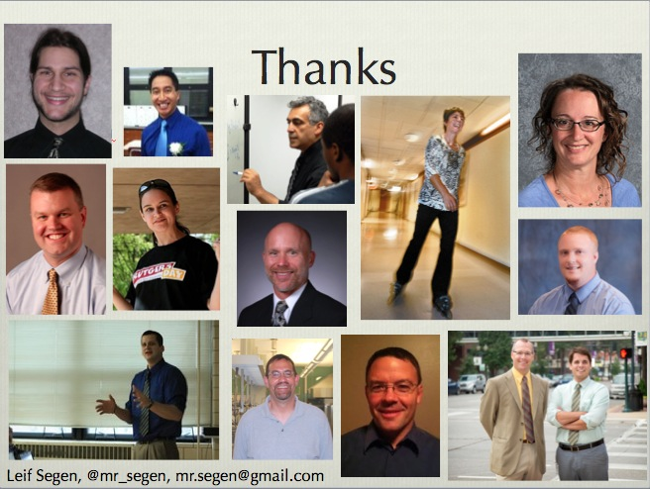

Slide 45

Cedar Rapids CSD. Big Ideas Group. http://bigideasgroup.org/
Clough, M., Berg, C., Olson., J. “Promoting Effective Science Teacher Education and Science Teaching: A Framework for Teacher Decision-Making.” Intl. J. Sci. & Mat. Ed., 2008.
Next Generation Science Standards
Rowe, M. “Wait-Time: Slowing Down May Be a Way of Speeding Up.” Journal of Teacher Education, Jan-Feb 1986.
Schwartz, M. “Depth vs. Breadth: How Content Coverage in High School Science Courses Relates to Later Success in College Science Coursework.” Sci. Ed., 2008.
Stanford University. Climate Change Education. https://pangea.stanford.edu/programs/outreach/climatechange/curriculum
Masterpiece Theater

